Slide 1
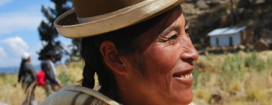
The multiple role of farmers in
a sustainable society
challenges, needs and opportunities
Padulosi S, J. Devra, A. Drucker, F. Mattei and B. Cogill
Bioversity International
WFO General Assembly, Consiglio Nazionale dell’Economia e del Lavoro (CNEL)
Rome, June 7, 2012

Slide 2
Content
Trends and challenges
Agrobiodiversity contributions
Role of farmers
Needs and opportunities
Recommendations

Slide 3
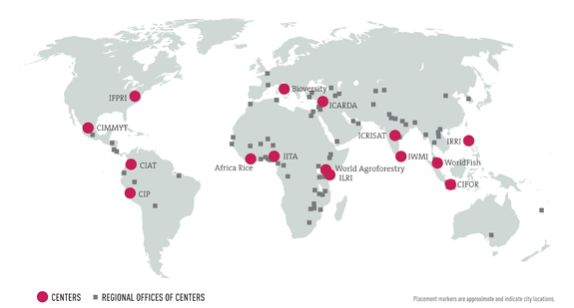
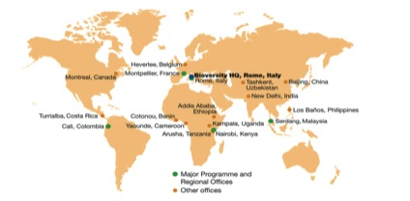

CGIAR and Bioversity International
The Consultative Group on International Agricultural Research (CGIAR), established in 1971, is a strategic partnership of diverse donors that support 15 international Centers
CGIAR expenditures amounted to US$572 million in 2009, the single largest investment made to mobilize science for the benefit of the rural poor worldwide
Bioversity International, based in Rome but with offices around the world, works to investigate the conservation and use of agricultural biodiversity in order to achieve better nutrition, improve smallholders’ livelihoods and enhance agricultural sustainability

Slide 4
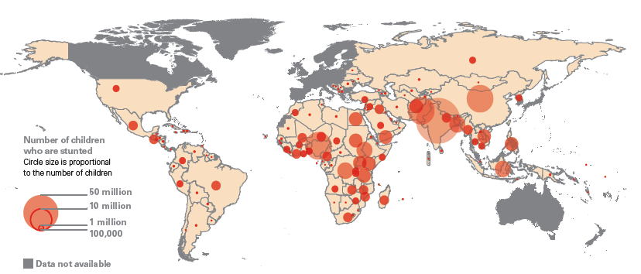
Food insecurity and malnutrition
UNICEF, 2009
200 million children are chronically undernourished
2 billion people have micronutrient deficiencies
60% of child deaths have an underlying cause of poor nutrition
1.6 billion people are overweight or obese
Notes:
A declaration was made promising that the world would be food secure in 1996. This was reaffirmed in 2000 with the MDGs. As of 2010, we are far off the mark in ensuring that our global population is food secure and that countries are on track to meet the MDG1 hunger target which is to cut those who are hungry in half by 2015. We have 1 billion who are hungry, 200 million children who are stunted and irreversibly damaged, 2 billion who suffer from sort form of micronutrient deficiency– many being iron and zinc deficient, and another at least 1 billion who are 20% or more over their ideal bodyweight. This obesity trend is not just found in the US and other wealthy countries – but is rapidly increasing in some of the poorest countries in the world like the Congo, Tanzania, as well as highly populated areas such as China, India and Brazil.

Slide 5
Balanced & Nutritious Food:
A global imperative
“The right to food means not only access to an adequate quantity of food, but also the ability to have a balanced and nutritious diet [..] and one of the five priority actions is “supporting local food production so that consumers have access to healthy, fresh and nutritious foods”
Oliver De Schutter, UN Special Rapporteur on the Right to Food in his report to the UN Human Rights Council, on March 2012.

Slide 6
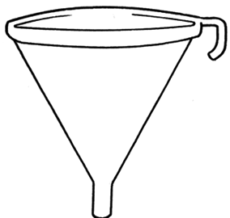
The shrinking of our food basket
300,000
100,000
30,000
7,000
120
30
3
Known plant species
Used by humankind
Edible
Used as food at local level
Important at national scale
Provide 90% of plant calories
Provide 60% (rice, wheat, maize)

Slide 7
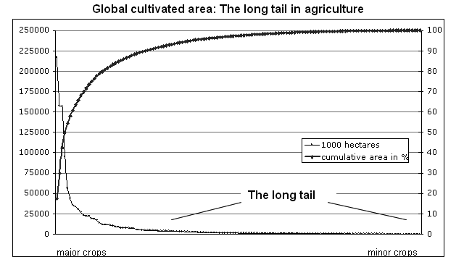
20 major crops cultivated over 82 % of global agricultural area and other 117 only on 18%
The long tail of minor crops
Ranking of the 137 most important crops. The 20 most important crops are cultivated on 82% of the global agricultural area, while the other 117 crops combined contribute to only 18%. Values are for the year 2007 (source: FAOSTAT 2008)

Slide 8
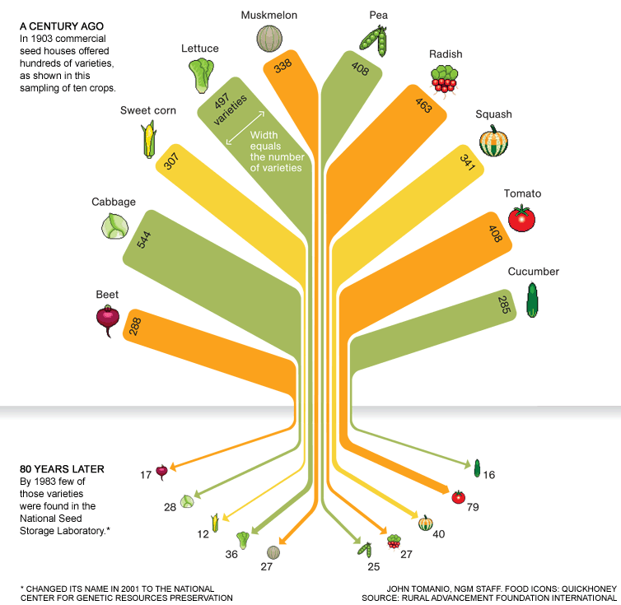
…and its impact on agrobiodiversity
National Geographic 2011
Study conducted in 1983 by the Rural Advancement Foundation International gave a clue to the scope of the problem. It compared USDA listings of seed varieties sold by commercial U.S. seed houses in 1903 with those in the U.S. National Seed Storage Laboratory in 1983. The survey, which included 66 crops, found that about 93 percent of the varieties had gone extinct..
Notes:
Our Dwindling Food Variety
As we've come to depend on a handful of commercial varieties of fruits and vegetables, thousands of heirloom varieties have disappeared. It's hard to know exactly how many have been lost over the past century, but a study conducted in 1983 by the Rural Advancement Foundation International gave a clue to the scope of the problem. It compared USDA listings of seed varieties sold by commercial U.S. seed houses in 1903 with those in the U.S. National Seed Storage Laboratory in 1983. The survey, which included 66 crops, found that about 93 percent of the varieties had gone extinct. More up-to-date studies are needed.

Slide 9
More examples
In the United States an estimated 90 percent of historic fruit and vegetable varieties have vanished.
In the Philippines thousands of varieties of rice once thrived; now only up to a hundred are grown there.
In China 90 percent of the wheat varieties cultivated just a century ago have disappeared.
In Italy of the 8,000 varieties of fruit trees recorded in the late 1800s only 2,000 exist and of these 1500 are under threat.
As for the 8,000 known livestock breeds, 1,600 are endangered or already extinct.
Notes:
Wheat, rice and maize > ½ the world’s food energy and provide up to 70-80% of energy for a person’s diet daily in the developing world.
These cereals are high in carbohydrates so they do provide energy, have low to moderate protein but are low in micronutrients; often poor quality and overprocessed. Because these are the foods that are largely consumed daily, most suffer from limited diet diversity with profound micronutrient, protein and essential fat deficiencies. This also leads to poor child undernutrition due to Poor infant and young child feeding sources – stunting and poor development
Further, Due to heavy milling, many nations fortify refined flours;Unprocessed grains are often considered “poor man’s food” or not preferred
Asian Green Revolution: Significant increase in production of wheat and rice but many of the secondary food grains such as pulses and millets were not emphasized. India is one of the worst states of undernutrition and carries the heaviest burden.

Slide 10
Complexity of human nutrition calls for diet diversity and a food systems approach
Notes:
Probably one of the best known examples of such ecological complementarity that also results in net nutritional benefit comes from the Mesoamerican “three sisters”. The combination of corn (a grass), beans (a nitrogen-fixing legume) and squash (a low-lying creeper) maximizes trait differences for growth and resource use efficiency between species (Risch and Hansen, 1982), resulting in higher yields compared to those obtained through three monocultures of these crops. The corn is a grass species particularly efficient in maximizing photosynthesis in warm environments. In structure, the corn grows straight and tall adding a vertical dimension to the system. The vine-like bean takes advantage of the growth form of the corn for structural support that also enables it to reach more sunlight. The beans are also unique in their capacity to bring atmospheric nitrogen in the system by symbiotic nitrogen fixation, this nitrogen becomes available to the corn in subsequent cropping seasons. The interaction between the corn and beans is an example of complementarity where the over-yielding is due to a positive interaction between the species. The third member of this assemblage, squash, does not perform as well as corn in direct sunlight, and thus occupies the remaining space near the ground where light is somewhat reduced, and humidity is increased reducing photorespiration (Gliessman, 2006). The addition of squash can decrease the amount of soil lost to erosion by its low lying nature and broad leaves ensuring greater soil coverage. The added productivity from squash does not so much come from positive interactions with the beans and maize, but rather comes from the capacity of the squash to use resources (namely light) that are not captured by the corn and beans, an example of resource partitioning.
It is not only that these crops are ecologically complementary that is notable, but also that they are nutritionally complementary. The corn is an important source of carbohydrates and some amino acids. By adding the beans, the set of essential amino acids for a human diet becomes complete and important contributions in carbohydrates, dietary fiber, vitamin B₂ and B₆, zinc, iron, manganese, iodine, potassium, magnesium and phosphorus are made. Squash in contrast can be an important source of vitamin A depending on the variety. It is important to note that each of these crops can make an important contribution to human diet, however none of these crops in isolation provides total nutrition.

Slide 11
..leveraging potentials from neglected and underutilized species
Per 100 gm | Amaranth (leaf) | Cleome | Nightshade | Cabbage
Iron mg | 8.9 | 6.0 | 1.0 | 0.7
Calcium mg | 410 | 288 | 442 | 47
ß carotene ųg | 5716 | 10452 | 3660 | 100
Notes:
These averages hide important differences between varieties of same species, and between different growing areas and conditions. Nevertheless, key point is that local species and varieties can be much more nutritious.
Vegetables and breeding for nutrition ignored to date.
KENRIK poster for Maundu at Kenya National Museums

Slide 12
PROXIMATE NUTRIENT PROFILE OF MAJOR GRAINS AND MILLETS
Crop
Calorie
Protein
Fiber (g)
Ash (g)
Calcium
Phosphorus
-
Iron
K Cal
(g)
(mg)
(mg)
(mg)
Rice
345
6.8
0.2
0.6
10
160
0.7
Wheat
346
11.8
1.2
1.5
31
306
5.3
Maize
342
11.1
1.2
1.5
10
348
2.3
Finger millet
328
7.3
3.2
2.6
35.8
250
9.9
Foxtail millet
331
9.9
10.0
3.5
31
290
4.9
Little millet
341
7.7
7.6
1.5
27
220
7.0
Barnyard millet
346
10.8
14.7
4.0
20
280
2.9
Proso
millet
340
10.6
12.2
3.2
24
206
3.5
Crops | Phenyl alanine | Histidine | Isoleucine | Leucine | Lysine | Methionine | Threonine | Trypto phan | Valine | Argi nine
Rice | 2.80 | 1.30 | 3.00 | 5.00 | 2.30 | 1.50 | 2.30 | 0.80 | 3.80 | 4.80
Wheat | 2.80 | 1.30 | 2.20 | 4.10 | 1.70 | 0.90 | 1.80 | 0.70 | 2.80 | 2.90
Maize | 2.90 | 1.60 | 2.40 | 7.20 | 2.00 | 1.20 | 2.80 | 0.40 | 3.00 | 2.90
Finger millet | 6.2 | 2.6 | 5.1 | 13.5 | 3.7 | 2.6 | 5.1 | 1.3 | 7.9 | 5.2
Italian millet | 5.3 | 2.3 | 5.0 | 13.3 | 2.1 | 2.6 | 3.9 | 1.5 | 5.2 | 6.1
Proso millet | 5.2 | 2.2 | 4.5 | 12.9 | 2.2 | 2.0 | 3.4 | 0.9 | 5.1 | 4.4
Kodo millet | 5.8 | 1.8 | 5.4 | 10.2 | 3.3 | 1.7 | 2.9 | 0.8 | 5.6 | 4.2
Recommended | 6.0 | - | 4.0 | 7.0 | 5.5 | 3.5 | 4.0 | 1.0 | 5.0 | -

Slide 13
Agro-ecosystem degradation
“ Nearly 2 billion hectares and 2.6 billion people have been affected by significant land degradation resulting from large-scale agricultural practices associated with the Green Revolution. Today, 70 percent of freshwater withdrawals are for agricultural irrigation, causing salinization of water supplies in developed and developing countries alike. The overuse and misuse of artificial fertilizers and pesticides have produced toxic runoffs which create coastal dead zones and reduce biodiversity.”
(IAASTD 2008: International Assessment of Agricultural Knowledge, Science and
Technology for Development - Summary for Decision Makers of the Global Report).

Slide 14
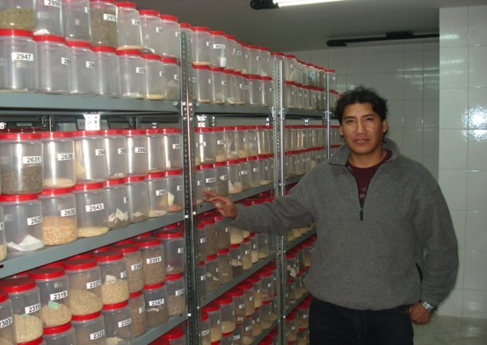
Conservation of ABD: how well?
State of the World Report of PGRFA (FAO 2010)
7.4 millions accessions in 1,740 ex situ gene banks
Major crops / commodities well covered
Gaps for landraces, CWR, neglected and underutilized species/NUS
In fact largest amount of ABD is conserved in situ/ on farm!

Slide 15
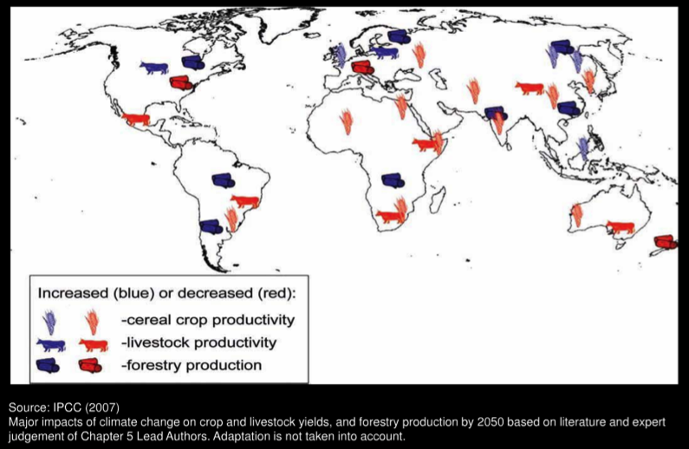
Climate change: its impact on agricultural productivity

Slide 16
Roles of Agrobiodiversity
Food and nutrition security
Reduce food dependence of countries
Source of medicines
Contributions for richer and tastier meals
NUTRITION HEALTH
Crop diversification and income opportunities
Employment opportunities , “empowerment”
Contribute to self-reliance” of developing countries
INCOME GENERATION
Reduction of impact of agricultural practices
Sustainability of cultivation practices
Contribution on pest and disease control
Soil conservation, fertility, heath
Contribution to optimization of use of resources/ envmt.
Ecosystem conservation, stability
ECOSYSTEM SERVICES
Contribution to safeguard culture and tradition, identity etc
CULTURE

Slide 17
..and of farmers that harness these roles and benefits
Sustainable society
Agrobiodiversity
Nutrition & Health benefits
Strength
Endurance
Cognition
Risk taking
Productivity
…
Agriculture
Agriculture benefits
Livelihoods
Income
Employment
Food security
Gender equity
Dietary diversity
…
Nutrition
Health
Notes:
Biodiversity provides the source of material to agricultural activities which lead to nutrition and health outcomes

Slide 18
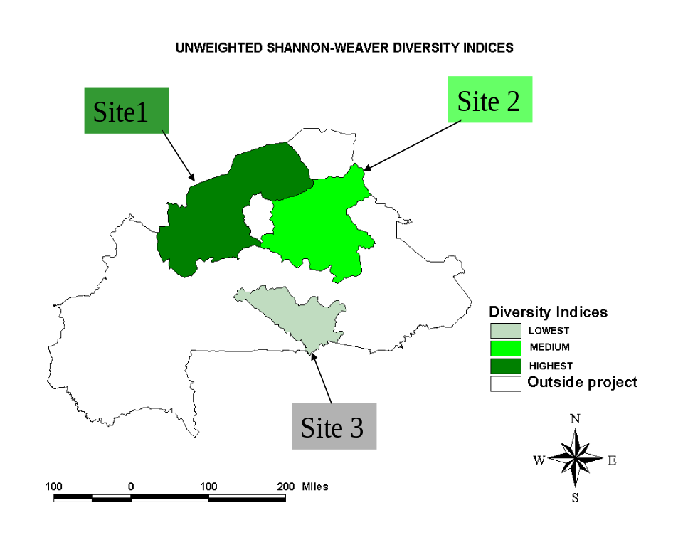
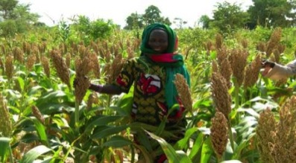
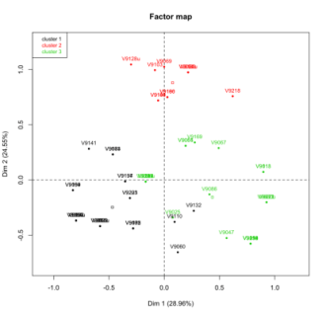
  Diversified varieties adapt to unpredictable environmental conditions
Unpredicatable rainfall =
Variety diversity
Early maturing
Late maturing
Uzbekistan and Kazakhstan
(Baymetov et al 2012 unpublished data)
Apple tree diversity in flowering times within early, middle and late maturing varieties:
IK - strategy for unpredictability of frost
Middle maturing
Notes:
Farmers may use a portfolio of varieties to manage different abiotic and biotic stresses. It may be uncertain when rainfall will fall and farmers may have different varieties they use in a dry or wet year. Farmers may use particular varieties for poor soils, they may use varieties that are more cold tolerant. They may also plant mixtures of different varieties of one crop to manage pest and disease.
Local varieties may be more adapted to a particular environment than the improved varieties – in that if both improved and local varieties are grown in one area without inputs such as fertilizer or pesticides the local variety may produce more. This better adaptation would mean reduced agricultural inputs (such as fertilizer and pesticides) – thus reduced costs to farmers, and hopefully reduced ground water pollution and less impact on human health and on other organisms in the production system such as beneficial pollinators and soil micro-organisms.

Slide 19
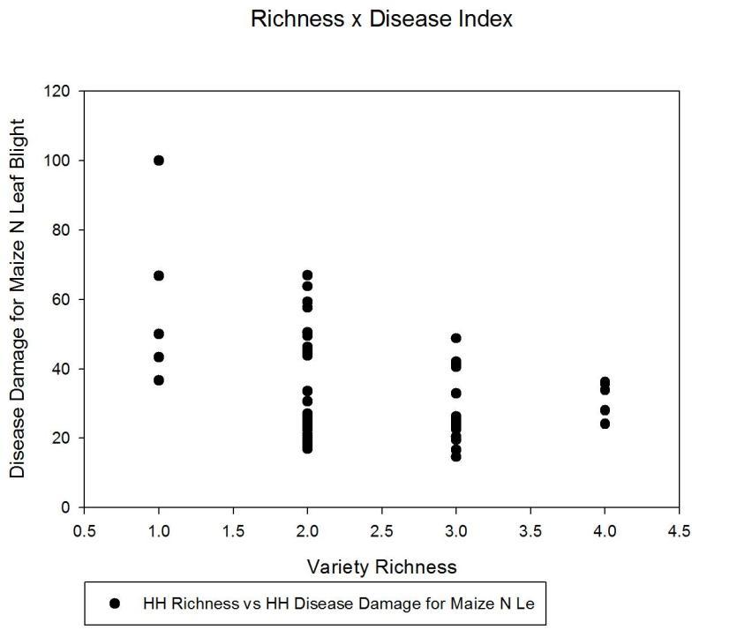
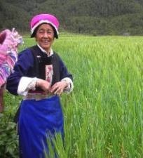
Higher variety richness - less variance in damage
- a risk minimizing argument for diversity
Peng et al., 2010, unpublished datea

Slide 20
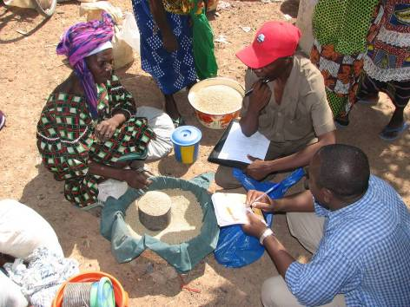
Collective Actions and supportive community-based institutions
Strategic in supporting farmers’ capacities to access, conserve and benefit from agrobiodiversity

Slide 21
  Management of informal seed systems
Forest / wild
Farmers
Distribution
Gene Bank
(ex situ)
Seed
1. Saved own
Seed quality control
Planting
Exchange
Market
Cultivation
INFORMAL
SYSTEMS
75-97%
2. Barter/gift
3. Sale/purchase
Harvest
Storage
Consumption
Breeding
Seed production
FORMAL
SYSTEMS
3-25%
Notes:
Traditionally farmers search, select and maintain local crop populations that matters to their livelihoods. Either domesticated from the forest or obtained from the community, majority of farmers keep their own seed.
Most rural farming communities in developing countries continue to use traditional or informal sources of seed and vegetative planting materials to meet their seed needs. Either they save their own seed or they obtain seed from sources such as relatives, neighbours and local markets independently of the formal certified seed sector. The operation of informal seed systems is clearly important to the maintenance of crop genetic diversity on farm.
Variation in production, market fluctuations and events such as floods or hurricanes will also have a substantial effect on the availability of seed locally and the diversity of the materials maintained in production.
This process of local crop development is the basis of farmers overall strategies for adaptation and mitigation of local landrace population against climate change at local level.

Slide 22
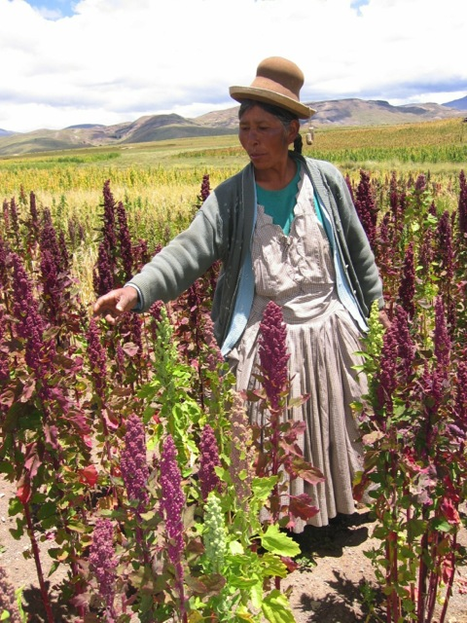
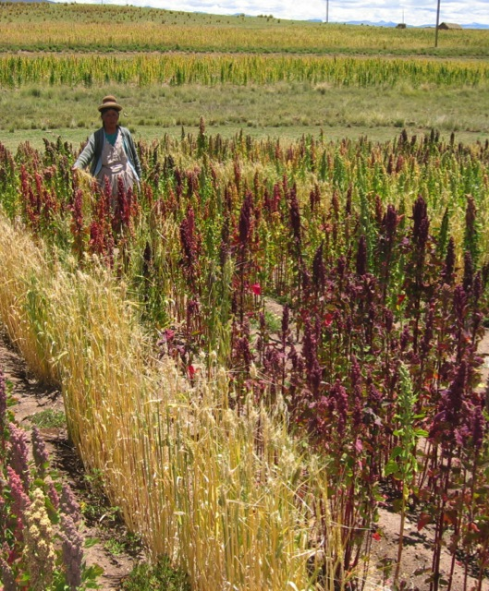
Mrs. Adelaja, conserving 125 acc. of quinoa (Peru, 2006)

Slide 23
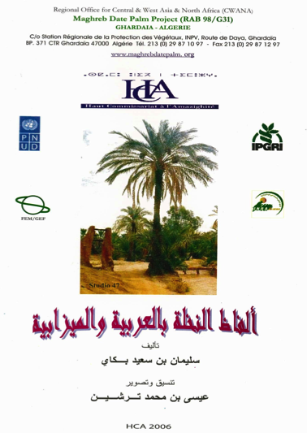

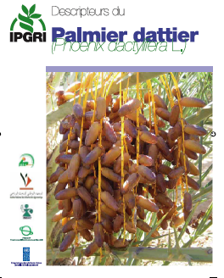
Safeguarding indigenous knowledge and valorizing it
Bioversity’s descriptor list for date palm (above) and the one (left) developed by Mr Ben Said in Arabic and in his local language (“Tamazight”): precious documentation of classification of date palm diversity by farmers in North Africa.

Slide 24
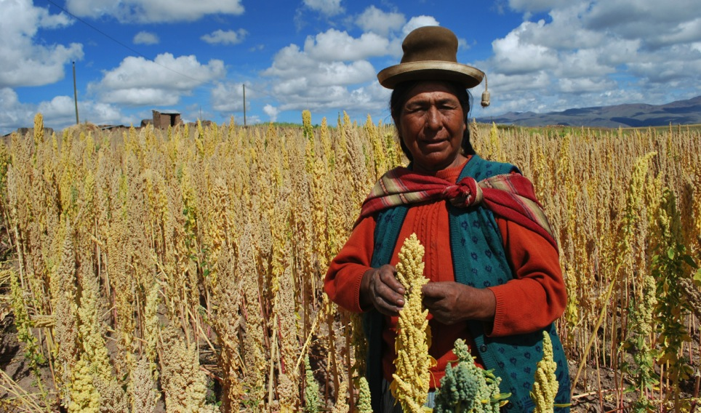
Recommendations
First of all we need recognition!

Slide 25
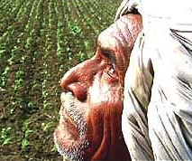
Strengthen in situ/ on farm research
How much genetic diversity is on farm and how it is being used?
How much diversity and IK, culture, traditions are being lost?
How this loss is affecting farmers’ livelihood?
How to support farmers capacities in harnessing the benefits from ABD for their /society wellbeing?

Slide 26
Lend more support to local institutions & local seed networks
81
Dudhe anadi
181
Gift
115
172
Purchase
Ekle, anadi
Ekle
Mansara
Purchase
Madhese
Exchange
Gurdi
Purchase
48
Madhese
173
125
182
Purchase
53
Ekle
Kathe gurdi
Exchange
Exchange
Purchase
152
Seto gurdi
Pakhe
Jetho budho
Purchase
Ekle
Gift
Gift
Gift
Rato anadi
Gurdi
OS
Gift
26
Exchagne
Kathe gurdi
Panhele
Kathe gurdi
23
67
126
OS
OS
Exchange
Madhese
Exchange
Exchange
Purchase
K. gurdi
Exchange
156
47
Sano madhese
Radha
Mansuli
Purchase
151
199
157
Exchange
Exchange
Mixed grain
Madhese
110
Exchange
37
Exchange
158
Madhese
OS
Exchange
Radha
OS
Radha
Mana muri
Exchange
Exchange
Radha 9
Madhe
159
Exchange
167
Gift
Gift
OS
111
Radha 9
Khumal 4
Sabitri
OS
Thulo madhese
9
38
Exchange
Exchange
Gift
Gift
144
Gift
Mansuli
41
Radha 9
163
Purchase
Gift
Gift
Exchange
Pakhe jarneli
Radha 9
Thulo mansuli
Radha 9
Food grain
16
Exchange
Exchange
76
Exchange
204
Radha 9
Pakhe jarneli
90
Exchange
Food grain
Exchange
Mansuli
Radha
205
8
Exchange
Exchange
Exchange
Radha
Naltumme
78
Exchange
206
Gift
Naltumme
Mansuli
Radha 9
Gift
Gift
Exchange
164
40
Radha 9
207
OS
Exchange
165
Notes:
Tropical fruits are an important component of tropical farming systems. They deliver good nutrition and incomes as well providing a source of medicine, timber, fuel and fodder for livestock. Very few tropical fruits are cultivated on a plantation scale; most are grown in home gardens and small plots. Asia, Pacific and Oceania region is a center of diversity for tropical fruits with more than 400 species. But this diversity is threatened.
The Tropical Fruit Conservation Project partnered with Australia, Malaysia, the Philippines, Thailand and Vietnam to improve conservation of tropical fruit genetic diversity. Funded by Australia Centre for International Agricultural Research (ACIAR)
Conserving tropical fruits is challenging for a number of reasons: seeds of many tropical species are difficult to store because they are sensitive to light and low temperatures; field genebanks are expensive to maintain and material conserved is vulnerable to pests, diseases and natural disasters.
The project chose species of importance to each country and to the region as a whole with the idea that results and protocols would be applicable to other species.
The project had three objectives: 1) develop cryopreservation methods and protocols, 2) develop alternative conservation and regeneration strategies and 3) dissemination of technologies to researchers and other users.
Progress was made in: developing techniques for the cryopreservation of Papaya, drying of Citrus seeds (to ensure long term conservation) and in the development of a whole new set of procedures for conserving mango. Mango provides typical example of a tropical fruit that cannot be easily stored. The seeds succumb rapidly to both desiccation and low temperatures. New procedure developed by scientists during the project, involves regenerating mango embryos from cell cultures that have been deep frozen.
Target species for each country partner:
Australia: papaya, mango, native species
Malaysia: Citrus, Rambutan
Philippines: Citrus
Thailand: Citrus, Rambutan
Vietnam: Citrus, Litchi, Longan, Persimmon

Slide 27
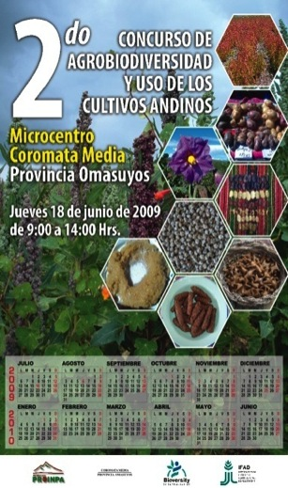

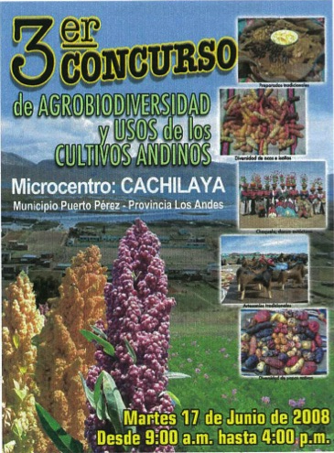
Support Collective Actions

Slide 28
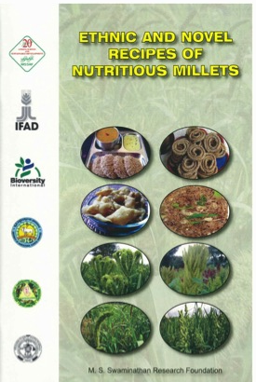
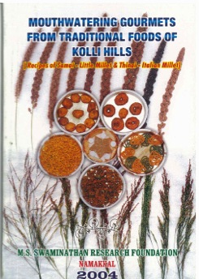
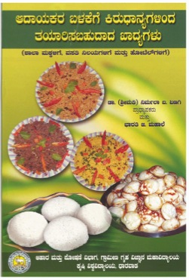

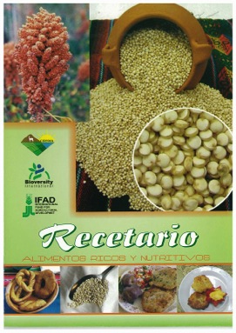
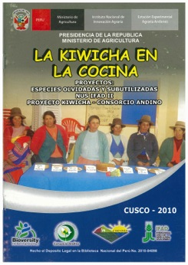

Valorize contribution of farmers in the cultivation/ use of ABD for more sustainable diets

Slide 29
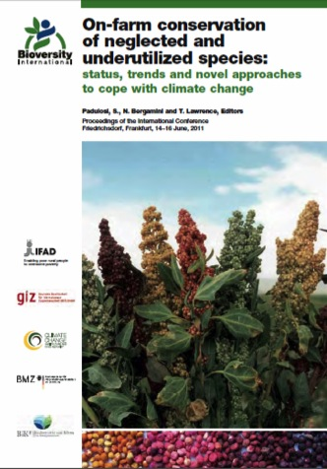
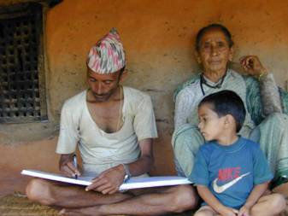
Methods/tools to empower farmers in conserving, documenting/ monitoring ABD
IFAD-CCAFS Project launched in 2011 working to test innovative Community-based agrobiodiversity documentation and monitoring systems (incl. Red List for cultivated species)

Slide 30
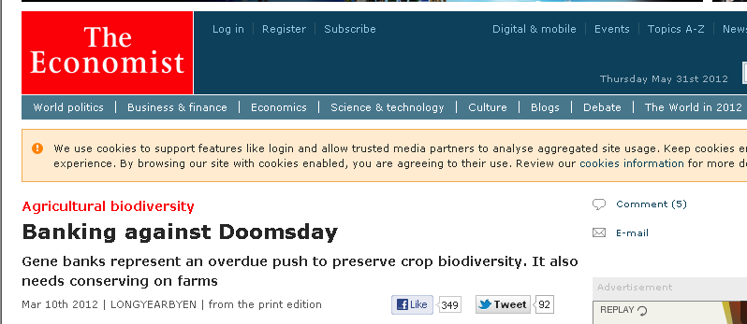
On farm conservation getting
the Media’ attention
March 10, 2012

Slide 31
Reward Systems for ABD conservation on farm
PACS: Payment for ABD Conservation Services
Define the conservation strategy (what do we want to conserve?)
Define the conservation goal (how – at what level – do we want to conserve it?)
Assess farmer Willingness to Accept (WTA) rewards to undertake conservation.
Award conservation service contracts while accounting for effectiveness, efficiency and equity trade-offs.
Identify how rewards can be financed by the project (i.e. sources of rewards/funding)

Slide 32
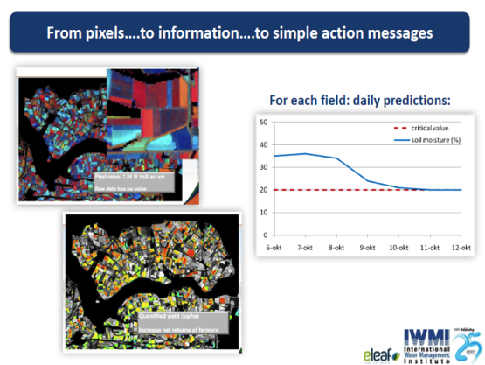
Support innovation for farmers decision making processes
Use of mobile phones and web based information systems to provide real time soil, water, pest/disease and temperature data to farmers
Informed decision making
Enhanced negotiation capacity with farm service providers
Lisa-Maria Rebelo 2012, IWMI
Notes:
Tanzania – 2.5% have access to the internet (and of these 2.5% 80% do so through mobile phones), while 55% with Mobile phones
Linking this to the Nepal proposal

Slide 33
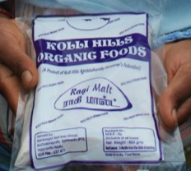
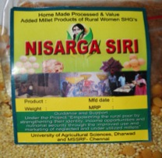
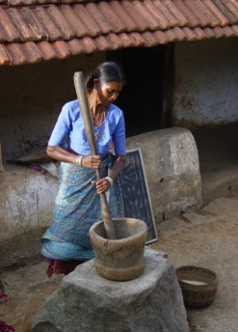
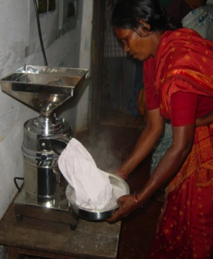
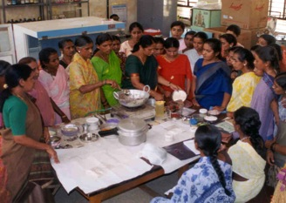
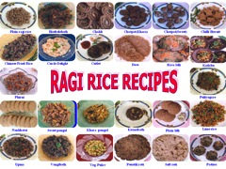
Support value addition and empowerment of marginalized farmers, women
IFAD Global Program on NUS

Slide 34


Linking farmers with private sector
Farmers-restaurant linkages developed by the IFAD Global Program on NUS in Bolivia

Slide 35
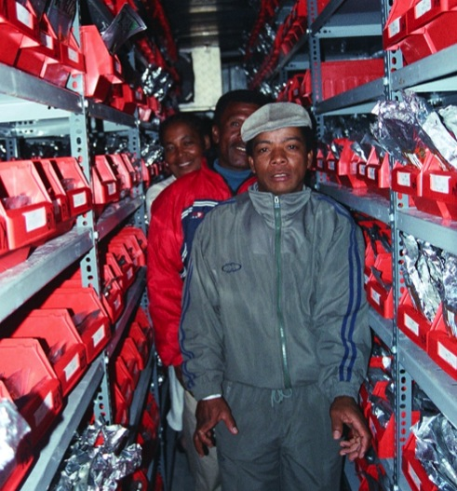
Link farmers with ex situ gene banks
Farmers-restaurant linkages developed by the IFAD Global Program on NUS in Bolivia

Slide 36
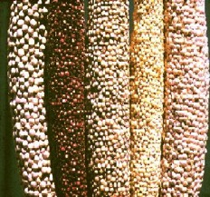
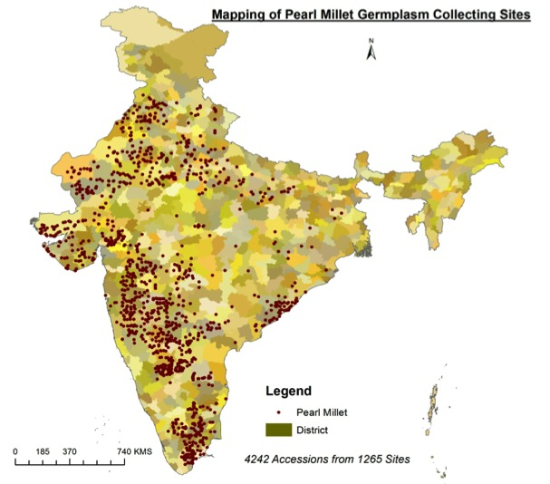

Enhancing capacities to cope
with climate change via ABD
Georeferencing
Documentation of traits for CC adaptation
Data documentation
Local weather data
Future climate
Prediction models
Climate analogues

Slide 37
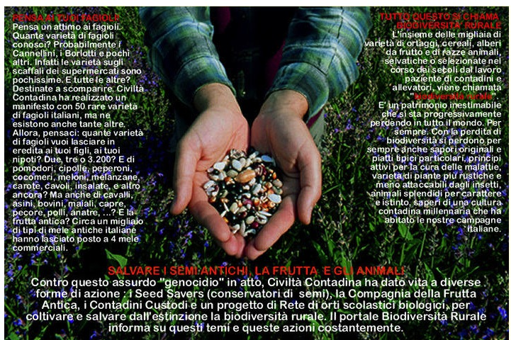
Launch a Global Network to support Custodian Farmers and on-farm conservation!

Slide 38
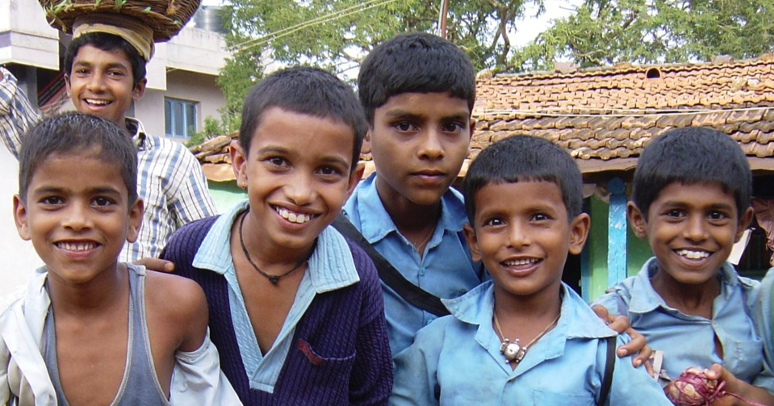
Thank you!

