Slide 1
Progress of IFAD-NUS3 in Nepal
(Year 2+)
Sajal Sthapit
Programme Coordinator

Slide 2
Outline
Project Fundamentals
Project Sites
Implementing Partners & Linkages
Progress for Year 2+
Challenges, Needs and Opportunities
Publications
Recommendations

Slide 3
Project Fundamentals
Goal: To facilitate more effective use, management and conservation of local agrobiodiversity by communities and stakeholders, particularly in the context of food security, nutrition, income generating potential and adaptation to climate change.
Improve access to NUS seeds
Improve information management & monitoring
Linkages between farmers & stakeholders
Build motivation through recognition

Slide 4
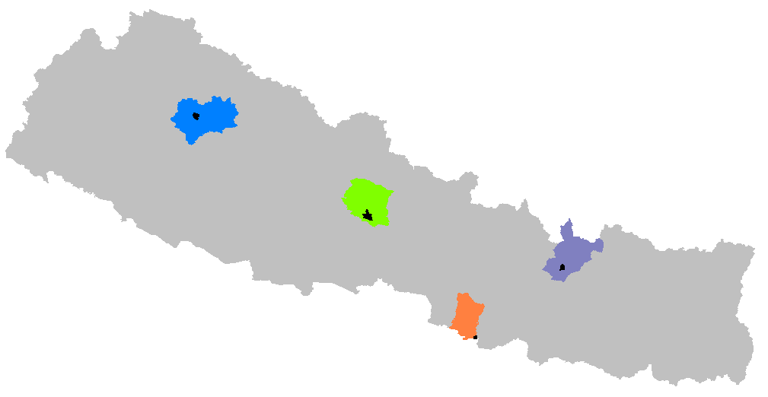
Project Sites
Talium VDC, Jumla
Pokhara and surrounding villages, Kaski
Kachorwa VDC, Bara
Namdu VDC, Dolakha
Notes:
Talium: High hills, level of intervention and market reach - low

Slide 5
Implementing Partners
NARS
  Hill Crops Research Programme (Dolakha)
  National Genebank
CSOs:
  Network for Agrobio. Conservation (NABIC)
Local stakeholders:
  Lekhnath Municipality, DADOs, business actors, schools and Rotary Clubs in Pokhara
Anamolbiu Pvt. Ltd.
Bioversity Intl, MSSRF, Proinpa, IFAD

Slide 6
Linkages, Synergies and Resource Leverage
RESMISA – Revalorizing Small Millets in South Asia
Community-based Biodiversity Management in Nepal
Genetic Resources Policy Initiative – 2
Diversifying access to diverse seeds
UNEP/GEF Biodiversity Portfolio Approach
Govt. of Nepal’s IFAD funded “Improved Seeds for Farmers Programme”

Slide 7
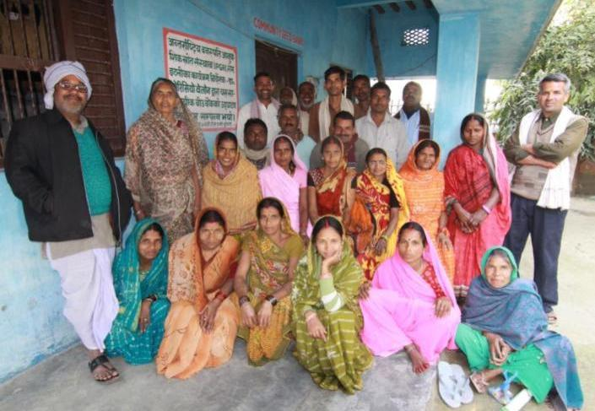
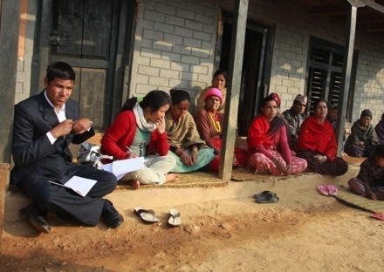
Act 3.2: Training of Community Members
Enhanced capacity of community members for documentation and monitoring
Village level workshops to inform and initiate planning with community members
Community level trainings on CBM, four cell analysis conducted

Slide 8
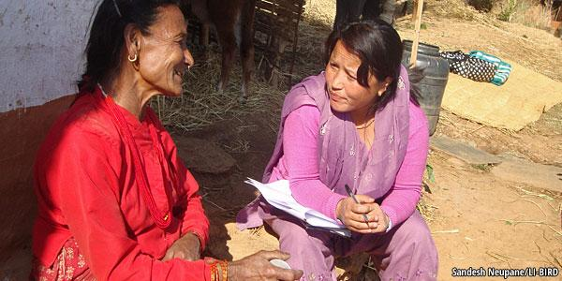
Act 3.3: Survey and Documentation
Information produced will contribute to more effective conservation of target species
Stratified proportionate sampling process
1171 HHs in 4 sites
Data entry and cleaning completed
Notes:
In 2013, the agricultural biodiversity benchmark surveys were completed in all four project sites. Of the total 1171 surveyed households, 309 were in Lekhnath Municipality (Kaski), 279 in Namdu VDC (Dolakha), 314 in Kachorwa VDC (Bara) and 269 in Talium VDC (Jumla). Data entry has been completed and submitted to Bioversity. The data generated provides a baseline for designing further project interventions as well as testing project hypothesis and impacts. Gennifer Meldrum of Bioversity will conduct a training on using R Statistical Language in 5-7 August, which will further help with the analysis of the data. The survey is comprehensive and its analysis will be conducted piece by piece to test a series of hypothesis.

Slide 9

Act 3.4: Network of Custodian Farmers
Greater self-reliance of custodian farmers in their conservation work
Exchange Forum for Custodian Farmers’ Organized
Video on Custodian Farmers’ being developed
National Workshop scheduled
Understanding of who are custodian farmers developing

Slide 10
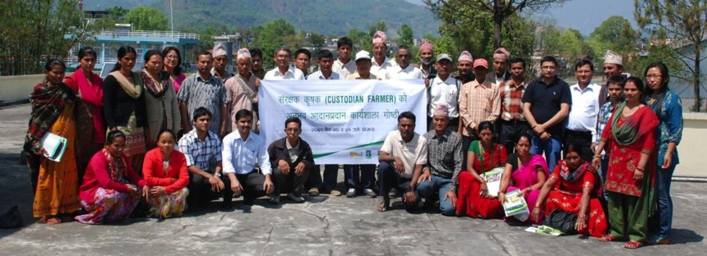
Exchange Forum for Custodian Farmers
Survey of promising farmers
An interactive forum for exchange of experience
Facilitate Participatory Seed Exchange
Refine concept of custodian farmer
25 farmers recommended by DWO, LI-BIRD, MDO, Parivartan-Nepal and SAHAS-Nepal.

Slide 11
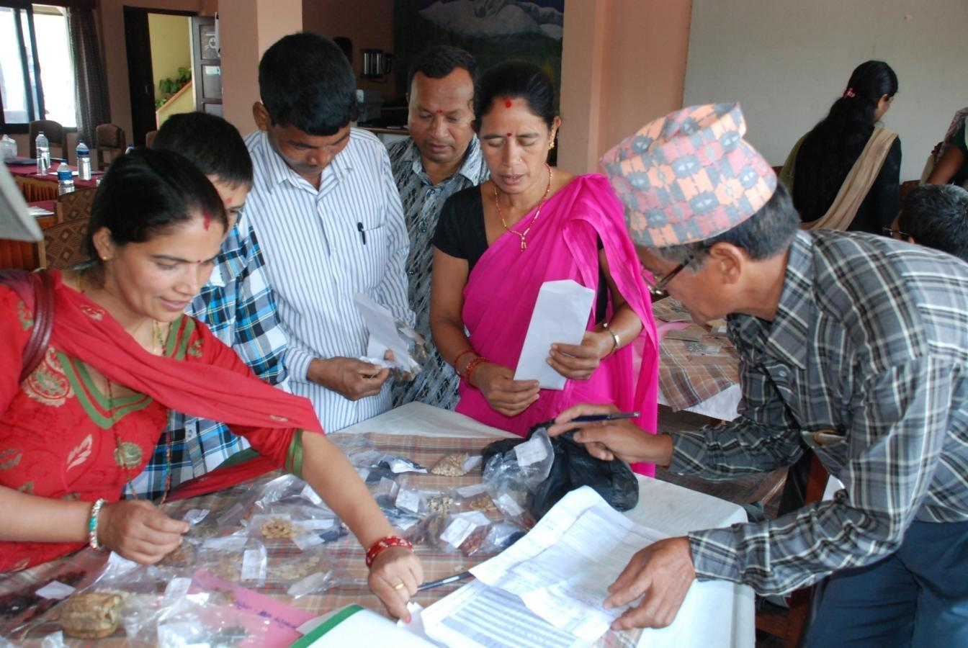
Participatory Seed Exchange
How did these farmers prioritize varieties?
7 Rarity
5 Taste
4 Frequency of Use
Seed and sapling exchange continues…
Notes:
The most common reason given was the rarity of the variety, with 7 farmers reporting this reason. The next common reason was better taste of the variety with 5 farmers reporting it, while usage was the third common reason, given by 4 farmers. Reasons such as seasonality of the seeds, ease of carrying, market potential, insect resistance were surprising given only by one or two farmers.

Slide 12
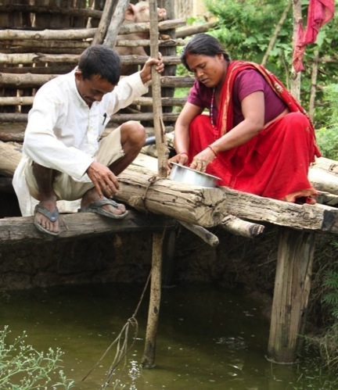
Evolving Definition of Custodian Farmers
Maintain Diversity
Promote
Adapt/
Innovate
Can a custodian farmer work alone?

Slide 13
Act 3.5 Linkages with ex situ conservation
Complementarity between ex situ and in situ efforts
National Workshop on CSBs paved the way
Types of CSBs
  PGR-based, PGR-focused, modern-variety-focused
Conservation of varietal diversity as key role
Harmonization of passport data format
Germplasm regeneration
Notes:
The workshop was organized in collaboration with Bioversity International, USC Canada Asia, Oxfam Nepal and the Community-based Biodiversity Management – South Asia Programme funded by the Development Fund of Norway. It brought together around 40 farmers, NGO/INGO staff, high level government officials and as well as international scientists.
The workshop was organized in five sessions covering: i) national and global review of history and conceptual understanding of CSB, ii) sharing of CSB experiences by NGOs and Government of Nepal’s Department of Agriculture, iii) potential linkages between CSBs and the national genebank, iv) farmers’ experiences in operating CSBs, and v) group work and recommendations. Following the presentations by different institutions and farmers, the participants were divided into four groups and given the following tasks: i) develop a common definition of CSBs and identify and define types and terminologies, ii) identify emerging issues and challenges and the possible ways to address them, iii) identify gaps in policy and develop action plans to facilitate better linkages between CSBs and the national gene bank, and iv) identify technical and management hurdles and discuss how farmers managing CSBs can address them, especially in absence of external support.
As a way to improve the linkages between in situ and ex situ conservation efforts, the project team harmonized the passport data collection form used by the national genebank for germplasm collection with the record keeping maintained by CSB. This will enable the CSBs to easily provide germplasm to the national genebank for safe-keeping, while the national genebank will also be able to acquire new germplasms without having to make additional collection missions.

Slide 14
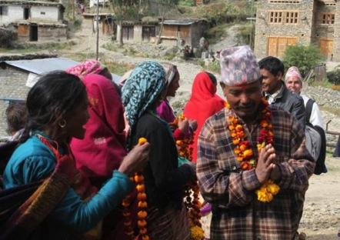
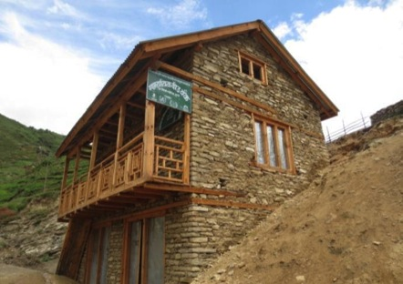
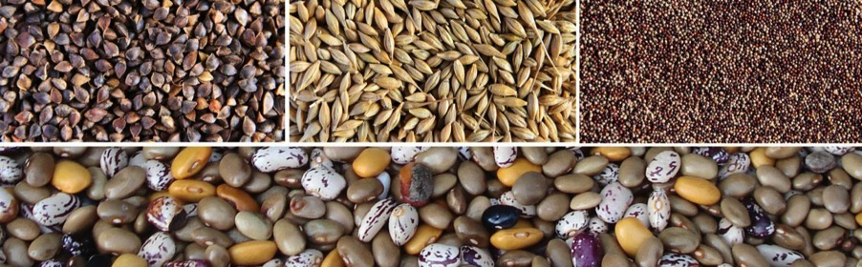
Community Seed Bank Support

Slide 15
Act 3.6: Doc. system for on-farm monitoring
Greater effectiveness of NARS/CBOs in documenting diversity & IK
Greater self-reliance of NARS/CBOs in establishing CBRs.
A safely backed up and coordinated documentation mechanism with greater integration with ex situ documentation efforts
Web application for central depository of CBRs in development
  CSOs contribute to information collection
  National information accessible to extensionists, CSOs, etc.

Slide 16
Tracking Seed Distribution (Bara example)
Crop | HHs that received seeds | HHs that saved seeds (%) | HHs that saved more seeds than they received | No. of people that took seeds from participating HHs
Barley | 49 | 41 (84%) | 17 (35%) | 0
Flaxseed | 34 | 22 (65%) | 14 (41%) | 0
Finger Millet | 54 | 24 (44%) | 19 (35%) | 0
Horsegram | 23 | 12 (52%) | 9 (39%) | 0
Pumpkin | 31 | 25 (81%) | 13 (42%) | 2
Fava Bean | 45 | 35 (78%) | 30 (67%) | 0

Slide 17
Act. 3.7: Red Listing
Field testing effectiveness of information management by farmer organizations
  Digitize CBR information: Variety name, population status, population trend, resource person
  Can farmers’ organizations and CSBs provide seeds of randomly identified rare varieties? Can it be a basis for CSBs to be rated (* to *****)?
  Do resource persons/ groups identified continue to maintain rare varieties?
  What traits tend to persist and what don’t?

Slide 18
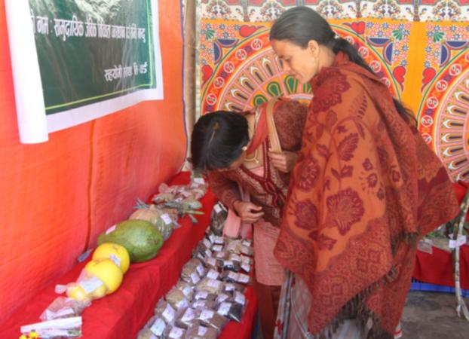
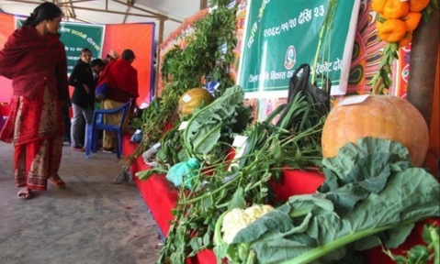
Act 3.8: Use Enhancement Actions
Enhanced capacities of communities in using traditional crops
Enhanced capacities of communities in sharing and accessing diversity of target crops
Integrating diversity fairs with agriculture fairs
Research on amaranth, aakabare chilli and kalo cauliflower

Slide 19
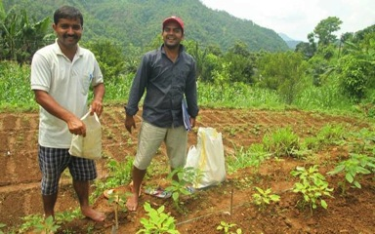
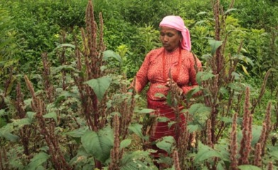
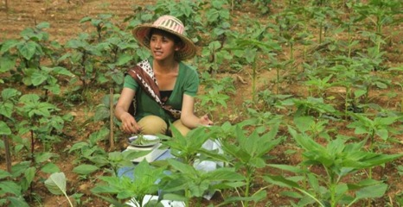
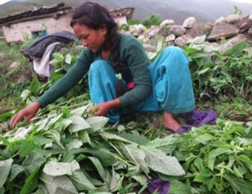
Research on Amaranth
Collaboration: LI-BIRD (287), HCRP (23) & Genebank (125)
292 accessions in trials in 3 locations
Notes:
Characterization of amaranth germplasm in the country.
Another example of collaboration between genebank, HCRP and LI-BIRD

Slide 20
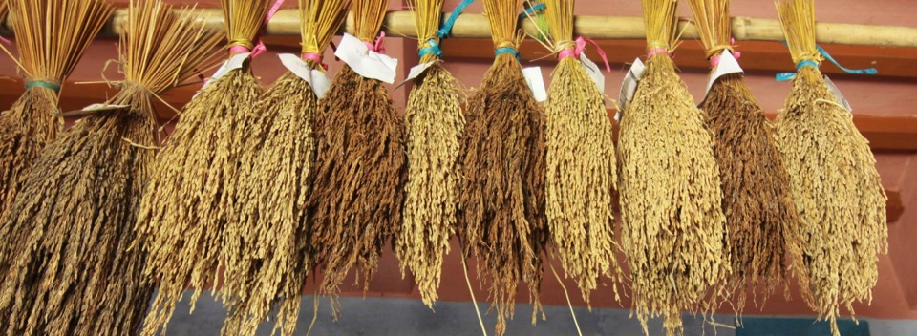
Act. 3.9: Piloting PACS
CBM Fund
  90 HHs in Kachorwa, Bara
  Conservation of one rare variety per HH in return
No contract based PACS to magnify population

Slide 21
Challenges, Needs & Opportunities
Continuing support for monitoring & evaluation and reflection with community needed
Research in new area leading to delay in some project activities (red listing and PACS)
Providing access to NUS planting materials
Project’s emphasis on new NUS crops have raised community and stakeholder enthusiasm
Not all participation is equal
Notes:
Weather especially challenging. Young researchers, which enthusiasm, but also meaning that lot of time dedicated to looking at issues in depth.

Slide 22
Participation & Knowledge In Decision-Making
Quality of decision-making also depends on information, knowledge and critical thinking
Farmer doesn’t or can’t attend
Farmer is consulted for inputs
Implementation is participatory, within a top-down framework
Deliberative participation of collective reasoning, reflection on values and plans
Farmer is a passive listener. Knows what is happening
Petition: farmer has right to be heard
Bargaining or deal-making. Adversarial, driven by self-interest
Degrees of participation adapted from: Crocker, D. 2007. J. of Human Dev. 8:431
Notes:
Participatory does not mean that the project team does not give input. It also does not mean that the project team simply imposes what it requires.

Slide 23
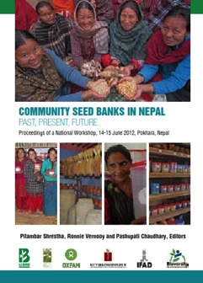
Publications
Community Seed Banks in Nepal
Global Review of CSBs (in works)
Walnuts in Nepal for ISHS Scripta
Custodian farmer profiles
Effectiveness of information management in on farm documentation
Farmers’ descriptor of amaranth, characterization of amaranth

Slide 24
Recommendations
Strengthen M&E of on-farm management by community institutions
Document and widely disseminate knowledge related to NUS
Plan community activities over the project period & beyond (if feasible) and leverage resources
Support communities to get access to seeds not available in the market
Even little emphasis on NUS crops can mean a lot

